Slide 1
SnowMan Game
By Abdulellah Alsaheel

Slide 2
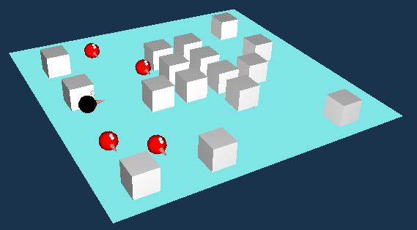
The Game Environment

Slide 3
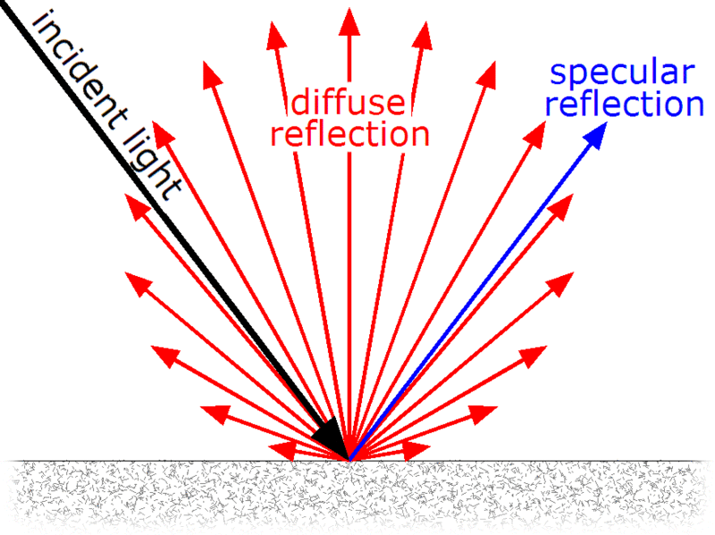
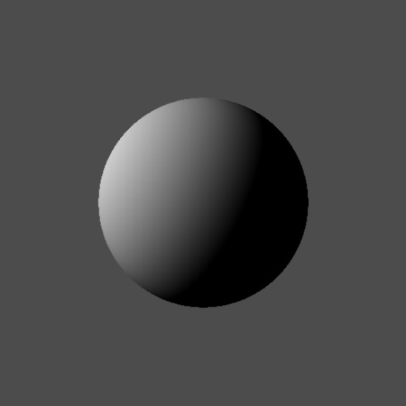
Diffuse Light
It is a light that shines upon an object indirectly. Light gets reflected from many angles rather than just one angle.

Slide 4
Perspective Projection
Definition:
It is alinear projection where three dimensional objects are projected on a picture plane. This has the effect that distant objects appear smaller than nearer objects.

Slide 5
Object Transformation
Alters the coordinates of each point on the object whereas the underlying coordinate system remains fixed.
How I specified the player coordinate:
glTranslatef(deltaAngle, deltaMove, 0.0f);
Note:
deltaAngle & deltaMove can have any value IN [-3.65,3.65]. This due to preserving the coordination system.

Slide 6
Object Animation/Movement
How is the player get animated:
if(px<0.0 && px!=0.0){
deltaAngle-=0.001;
px+=0.001;
} else if(px>0.0 && px!=0.0){
deltaAngle+=0.001;
px-=0.001;
}
// The same applies to py.
NOTE: px & py get increments or decrements by clicking the arrow keys.

Slide 7
Collision Detection
Detecting the player collision with a cube:
for(i=15;i>=0;i--){
if(deltaAngle<cubesx[i] && deltaAngle+0.001>=cubesx[i]-0.7 && cubesy[i]-deltaMove>-0.3 && cubesy[i]-deltaMove<0.3 && pd==4 && damage[i]!=3)
px=0;
}

Slide 8
Thanks!
Thanks!

